Slide 1
Top Down Parsing
Lecture 8

Slide 2
Topics Covered in Lecture 7

Slide 3
Lexical Analyzer vs. Parser
Phase | Input | Output
Lexical Analyzer | Sequence of characters | Sequence of tokens
Parser | Sequence of tokens | Parse tree

Slide 4
The Role of the Parser
Not all sequences of tokens are programs
Parser must distinguish between valid and invalid sequences of tokens
We need
  A language for describing valid sequences of tokens
  A method for distinguishing valid from invalid sequences of tokens

Slide 5
Context Free Grammars
A CFG consists of
  A set of terminals T
  A set of non-terminals N
  A start symbol S (a non-terminal)
  A set of productions P, where each rule r is of the form:
  Assuming X ∈ N
  X → ε , or
  X → Y₁ Y₂ ... Y_{n} where Y_{i} ∈ N ∪ T

Slide 6
Derivations and Parse Trees
A derivation is a sequence of productions
S → … → … → …
A derivation can be drawn as a tree
  Start symbol is the tree’s root
  For a production X → Y₁ … Y_{n}
  Add children Y₁ … Y_{n} to node X
  So on

Slide 7
Today we shall study
Parsing Techniques

Slide 8
Parsing Techniques
Two primary parsing techniques
  Top Down
  Bottom Up
These terms refers to the order in which nodes in the parse tree are constructed.
In Top Down approach, construction starts at the Root and proceeds towards the leaves.
In Bottom Up approach, construction starts at the leaves and proceeds towards the root.

Slide 9
Top-Down Parsing
Terminals are seen in order of appearance in the token stream:
  t₂ t₅ t₆ t₈ t₉
The parse tree is constructed
  From the top
  From left to right
1
t₂
3
t₉
4
7
t₅
t₆
t₈

Slide 10
Learn by Example
Consider the following grammar for a subset
of Pascal type declarations:
type ::= simple
| id
| array [ simple ] of type
simple ::= integer
| char
| num “..” num
Example: array [num .. num] of integer
where 1 and 10 are num tokens

Slide 11
Basic Top-down Parsing “Algorithm”
Construct the root of the parse tree, labeled with the start symbol. Initialize the current node to be the root, and initialize current token to be the first token in the input.

Slide 12
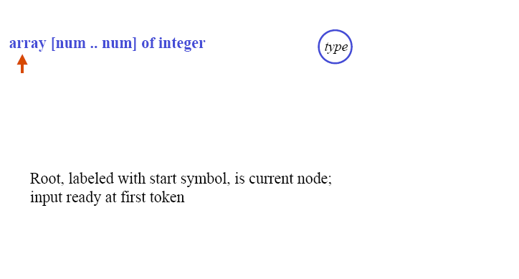
Learn by Example :
Step 1 :Building a parse tree top-down
Root Node
Current token

Slide 13
Basic Top-down Parsing “Algorithm”
Construct the root of the parse tree, labeled with the start symbol. Initialize the current node to be the root, and initialize current token to be the first token in the input.
If the current node is labeled with a nonterminal, select a production consistent with the current token, and construct child nodes of the current node for the symbols on the RHS of the production.

Slide 14
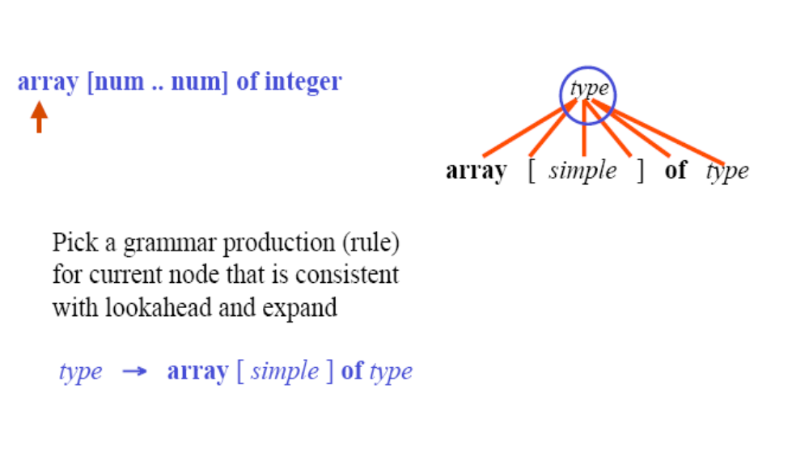
Learn by Example
Step 2: Building a parse tree top-down
Non terminal
Current token

Slide 15
Basic Top-down Parsing “Algorithm”
Construct the root of the parse tree, labeled with the start symbol. Initialize the current node to be the root, and initialize current token to be the first token in the input.
If the current node is labeled with a nonterminal, select a production consistent with the current token, and construct child nodes of the current node for the symbols on the RHS of the production.
Else if the current node is labeled with a terminal equal to the current token, advance the input, and set the current token to be the next token in the input.

Slide 16
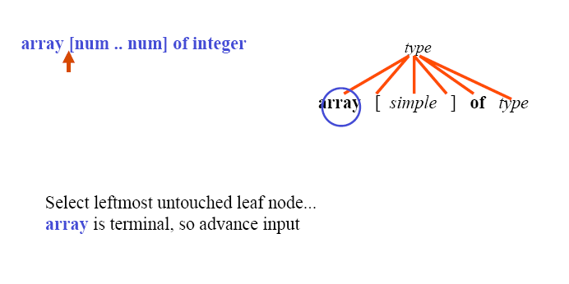
Learn by Example - Building a parse tree top-down (Cont)
Current token
Terminal

Slide 17
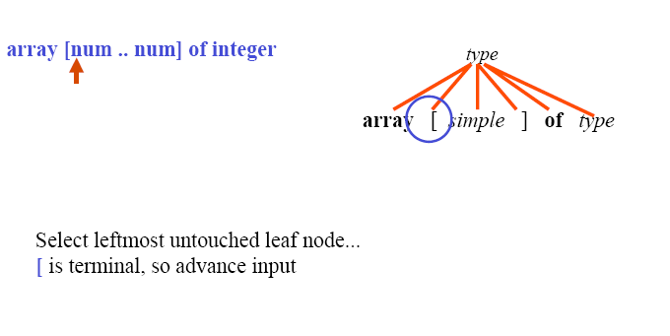
Learn by Example - Building a parse tree top-down (Cont)
Current token
Terminal

Slide 18
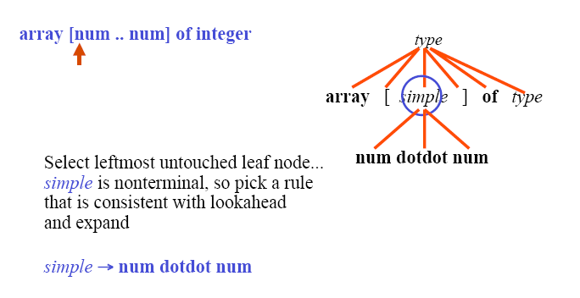
Learn by Example - Building a parse tree top-down (Cont)
Current token
Non Terminal

Slide 19
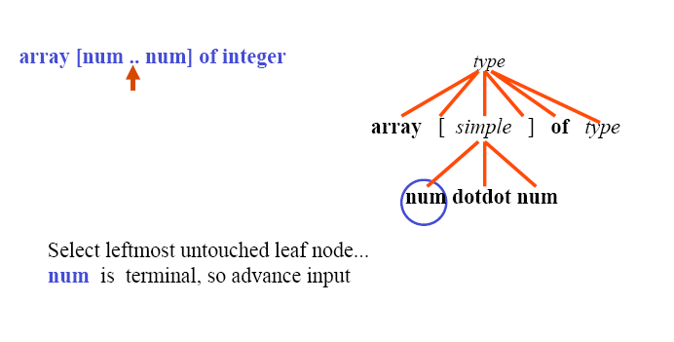
Learn by Example - Building a parse tree top-down (Cont)
Current token
Terminal

Slide 20
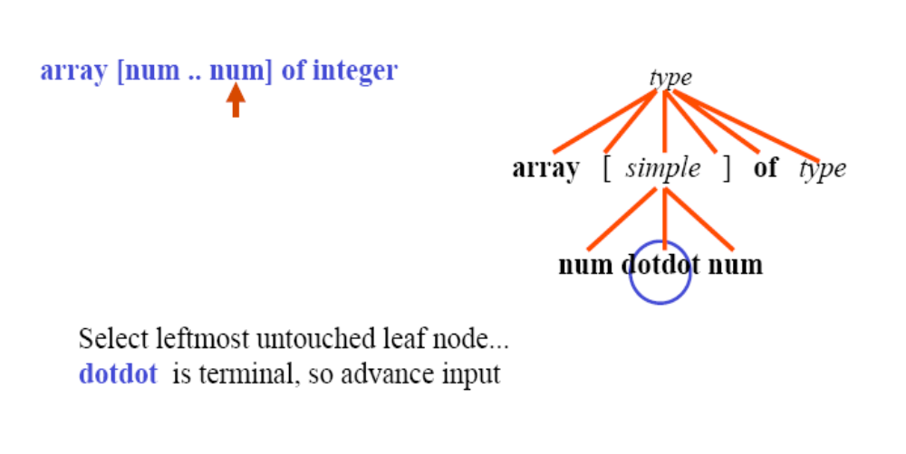
Learn by Example - Building a parse tree top-down (Cont)
Current token
Terminal

Slide 21
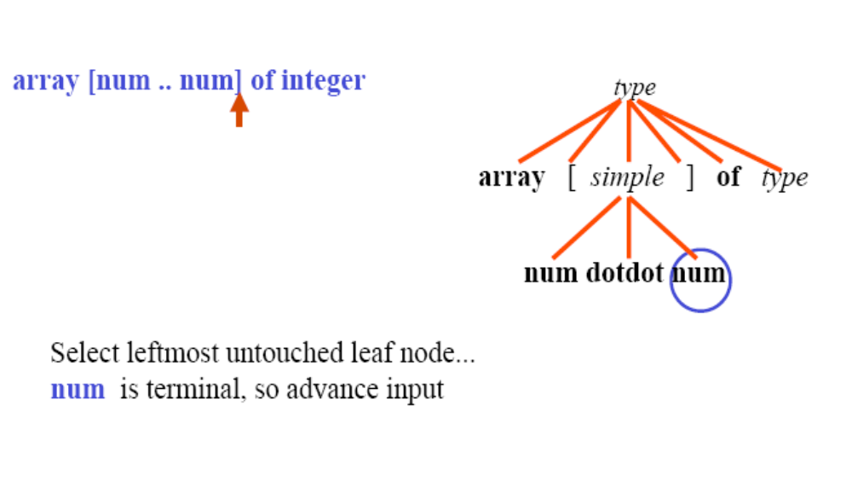
Learn by Example - Building a parse tree top-down (Cont)
Current token
Terminal

Slide 22
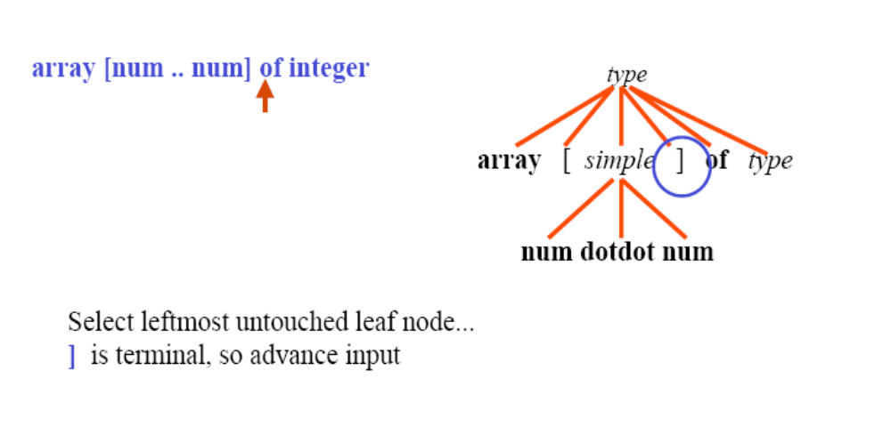
Learn by Example - Building a parse tree top-down (Cont)
Current token
Terminal

Slide 23
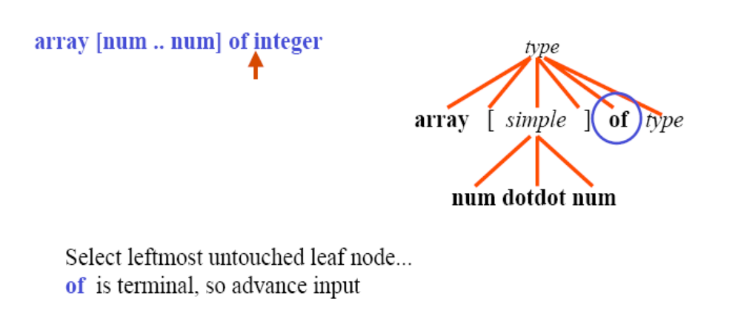
Learn by Example - Building a parse tree top-down (Cont)
Current token
Terminal

Slide 24
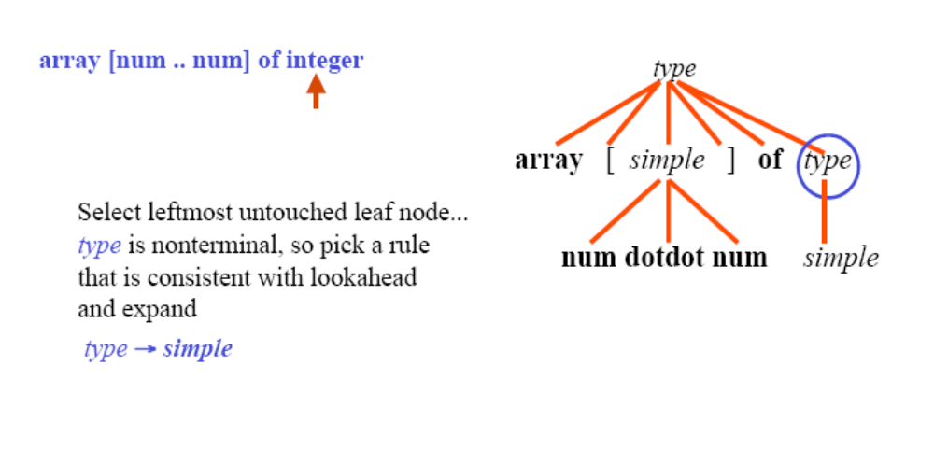
Learn by Example - Building a parse tree top-down (Cont)
Non terminal
Current token

Slide 25
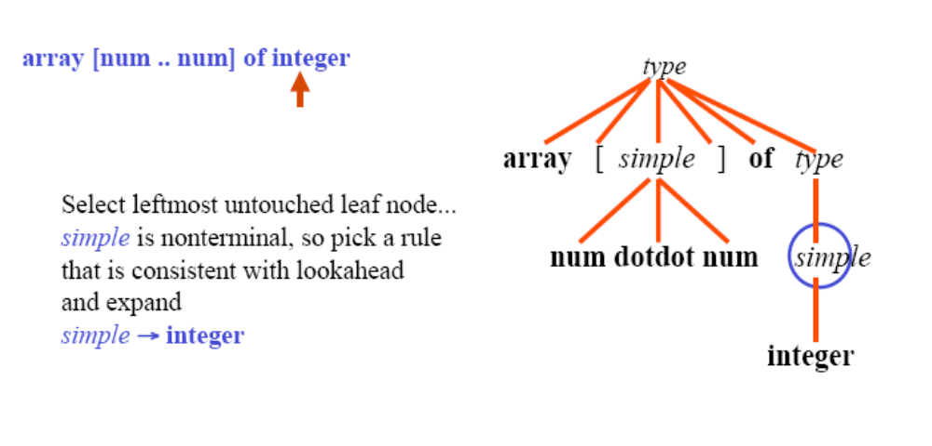
Learn by Example - Building a parse tree top-down (Cont)
Non Terminal
Current token

Slide 26
Basic Top-down Parsing “Algorithm”
Construct the root of the parse tree, labeled with the start symbol. Initialize the current node to be the root, and initialize current token to be the first token in the input.
If the current node is labeled with a nonterminal, select a production consistent with the current token, and construct child nodes of the current node for the symbols on the RHS of the production.
Else if the current node is labeled with a terminal equal to the current token, advance the input, and set the current token to be the next token in the input.
If all input has been consumed and all leaves of the parse tree are matched terminals, done! Else select leftmost untouched leaf node of the parse tree as the current node and go to 2.
(NOTE: In general, the choice of rule in 2 might not “work,” and backtracking may be necessary.)

Slide 27
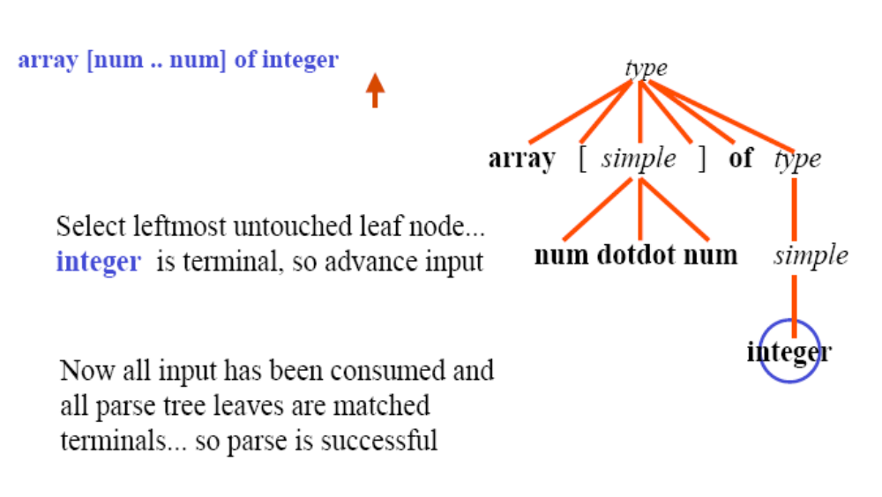
Learn by Example - Building a parse tree top-down (Cont)
Terminal

Slide 28
Learn by Doing
E→ E - T | T
T→ T * F | F
F→ Integer | ( E )
Make a top down parse tree for input: 3 - 6 * 2

Slide 29
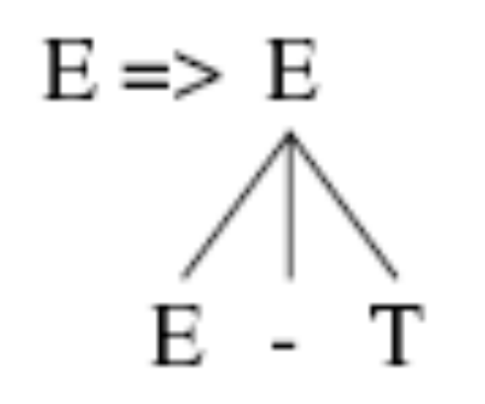
Solution
E→ E - T | T
T→ T * F | F
F→ Integer | ( E )
input: 3 - 6 * 2

Slide 30

Solution
E→ E - T | T
T→ T * F | F
F→ Integer | ( E )
input: 3 - 6 * 2

Slide 31
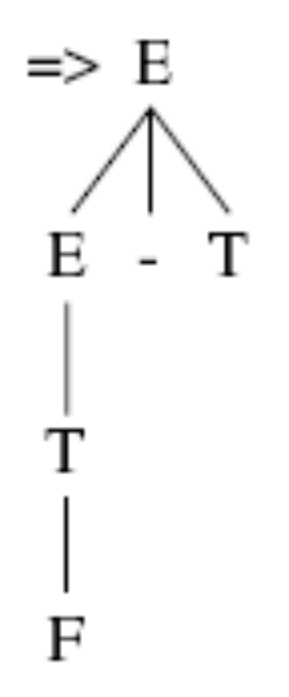
Solution
E→ E - T | T
T→ T * F | F
F→ Integer | ( E )
input: 3 - 6 * 2

Slide 32

Solution
E→ E - T | T
T→ T * F | F
F→ Integer | ( E )
input: 3 - 6 * 2

Slide 33
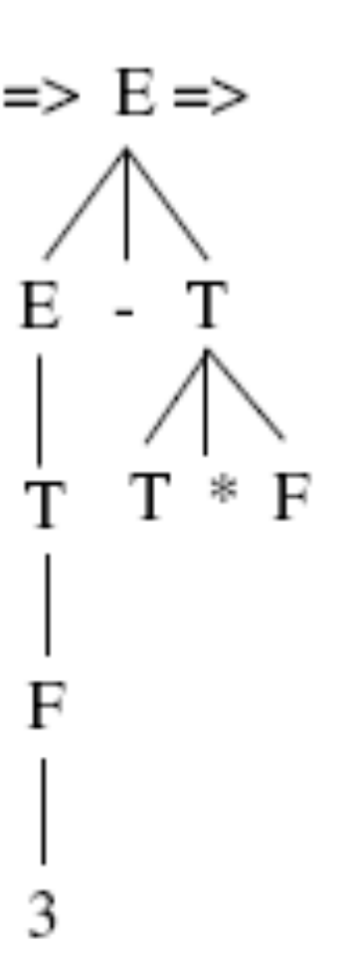
Solution
E→ E - T | T
T→ T * F | F
F→ Integer | ( E )
input: 3 - 6 * 2

Slide 34
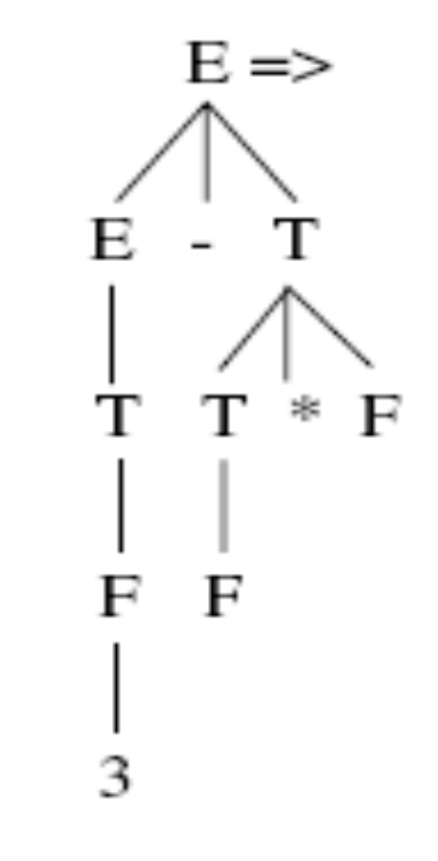
Solution
E→ E - T | T
T→ T * F | F
F→ Integer | ( E )
input: 3 - 6 * 2

Slide 35
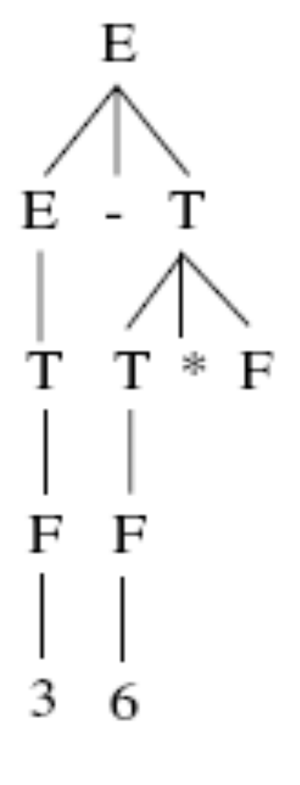
Solution
E→ E - T | T
T→ T * F | F
F→ Integer | ( E )
input: 3 - 6 * 2

Slide 36
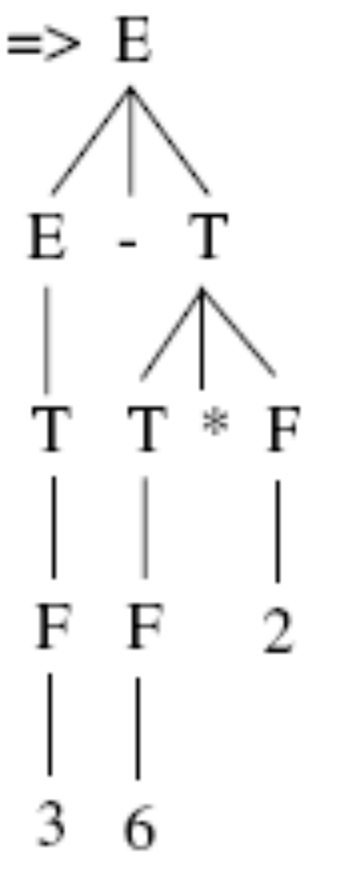
Solution
E→ E - T | T
T→ T * F | F
F→ Integer | ( E )
input: 3 - 6 * 2

Slide 37
Learn by Doing
Start → Expr
Expr → Expr + Term
| Expr - Term
| Term
Term → Term * Int
| Term / Int
| Int
Set of terminals
  { +, -, *, /, Int }
Set of Non terminals
  { Start, Expr, Term }
Draw a parse tree for Input 2-2*2

Slide 38
Parsing Solution
Parse
Tree
Remaining Input
Start
2-2*2
Sentential Form
Start
Current Position in Parse Tree

Slide 39
Parsing Solution
Parse
Tree
Remaining Input
Start
2-2*2
Expr
Sentential Form
Expr
Applied Production
Start → Expr
Current Position in Parse Tree

Slide 40
Parsing Solution
Parse
Tree
Remaining Input
Start
2-2*2
Expr
Sentential Form
Expr
-
Term
Expr - Term
Applied Production
Expr → Expr - Term

Slide 41
Parsing Solution
Parse
Tree
Remaining Input
Start
2-2*2
Expr
Sentential Form
Expr
-
Term
Term - Term
Term
Applied Production
Expr → Term

Slide 42
Parsing Solution
Parse
Tree
Remaining Input
Start
2-2*2
Expr
Sentential Form
Expr
-
Term
Int - Term
Term
Applied Production
Int
Term → Int

Slide 43
Parsing Solution
Parse
Tree
Remaining Input
Start
Match
Input
Token!
2-2*2
Expr
Sentential Form
Expr
-
Term
2 - Term
Term
Int 2

Slide 44
Parsing Solution
Parse
Tree
Remaining Input
Start
Match
Input
Token!
-2*2
Expr
Sentential Form
Expr
-
Term
2 - Term
Term
Int 2

Slide 45
Parsing Solution
Parse
Tree
Remaining Input
Start
Match
Input
Token!
2*2
Expr
Sentential Form
Expr
-
Term
2 - Term
Term
Int 2

Slide 46
Parsing Solution
Parse
Tree
Remaining Input
Start
2*2
Expr
Sentential Form
Expr
-
Term
2 - Term*Int
Term
Term
*
Int
Applied Production
Int 2
Term → Term * Int

Slide 47
Parsing Solution
Parse
Tree
Remaining Input
Start
2*2
Expr
Sentential Form
Expr
-
Term
2 - Int * Int
Term
Term
*
Int
Applied Production
Int 2
Term → Int
Int

Slide 48
Parsing Solution
Parse
Tree
Remaining Input
Start
Match
Input
Token!
2*2
Expr
Sentential Form
Expr
-
Term
2 - 2* Int
Term
Term
*
Int
Int 2
Int 2

Slide 49
Parsing Solution
Parse
Tree
Remaining Input
Start
Match
Input
Token!
*2
Expr
Sentential Form
Expr
-
Term
2 - 2* Int
Term
Term
*
Int
Int 2
Int 2

Slide 50
Parsing Solution
Parse
Tree
Remaining Input
Start
Match
Input
Token!
2
Expr
Sentential Form
Expr
-
Term
2 - 2* Int
Term
Term
*
Int
Int 2
Int 2

Slide 51
Parsing Solution
Parse
Tree
Remaining Input
Start
Parse
Complete!
2
Expr
Sentential Form
Expr
-
Term
2 - 2*2
Term
Term
*
Int 2
Int 2
Int 2

Slide 52
Policy Problem
Which production to use for each non terminal provided you have more than one choice?
One Approach: Backtracking
  Treat it as a search problem
  At each choice point, try next alternative
  If it is clear that current try fails, go back to previous choice and try something different
General technique for searching

Slide 53
Understanding Backtracking by Example
Parse
Tree
Remaining Input
Start
2-2*2
Sentential Form
Start

Slide 54
Backtracking Example
Parse
Tree
Remaining Input
Start
2-2*2
Expr
Sentential Form
Expr
Applied Production
Start → Expr

Slide 55
Backtracking Example
Parse
Tree
Remaining Input
Start
2-2*2
Expr
Sentential Form
Expr
+
Term
Expr + Term
Applied Production
Expr → Expr + Term

Slide 56
Backtracking Example
Parse
Tree
Remaining Input
Start
2-2*2
Expr
Sentential Form
Expr
+
Term
Term + Term
Term
Applied Production
Expr → Term

Slide 57
Backtracking Example
Parse
Tree
Remaining Input
Start
Match
Input
Token!
2-2*2
Expr
Sentential Form
Expr
+
Term
Int + Term
Term
Applied Production
Int
Term → Int

Slide 58
Backtracking Example
Parse
Tree
Remaining Input
Start
Can’t
Match
Input
Token!
-2*2
Expr
Sentential Form
Expr
+
Term
2 + Term
Term
Applied Production
Int 2
Term → Int

Slide 59
Backtracking Example
Parse
Tree
Remaining Input
Start
So
Backtrack!
2-2*2
Expr
Sentential Form
Expr
Applied Production
Start → Expr

Slide 60
Backtracking Example
Parse
Tree
Remaining Input
Start
2-2*2
Expr
Sentential Form
Expr
-
Term
Expr - Term
Applied Production
Expr → Expr - Term

Slide 61
Backtracking Example
Parse
Tree
Remaining Input
Start
2-2*2
Expr
Sentential Form
Expr
-
Term
Term - Term
Term
Applied Production
Expr → Term

Slide 62
Backtracking Example
Parse
Tree
Remaining Input
Start
2-2*2
Expr
Sentential Form
Expr
-
Term
Int - Term
Term
Applied Production
Int
Term → Int

Slide 63
Backtracking Example
Parse
Tree
Remaining Input
Start
Match
Input
Token!
-2*2
Expr
Sentential Form
Expr
-
Term
2 - Term
Term
Int 2

Slide 64
Backtracking Example
Parse
Tree
Remaining Input
Start
Match
Input
Token!
2*2
Expr
Sentential Form
Expr
-
Term
2 - Term
Term
Int 2

Slide 65
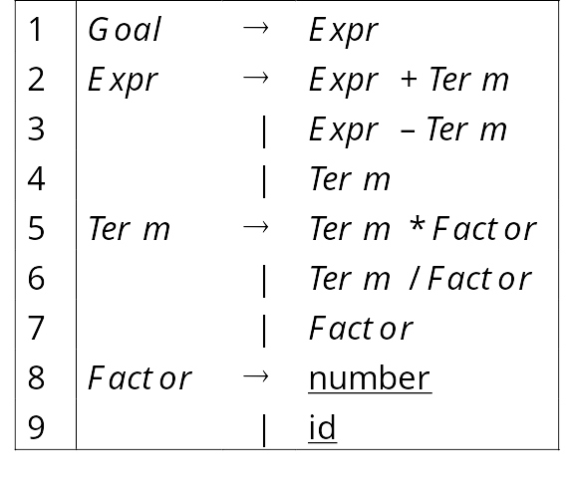
Learn by Doing
Suppose we have the following grammar
And the input x - 2 * y
Make a parse tree for the input using the production Expr → Expr + Term. Provide a reason if back tracking needs to be done.

Slide 66
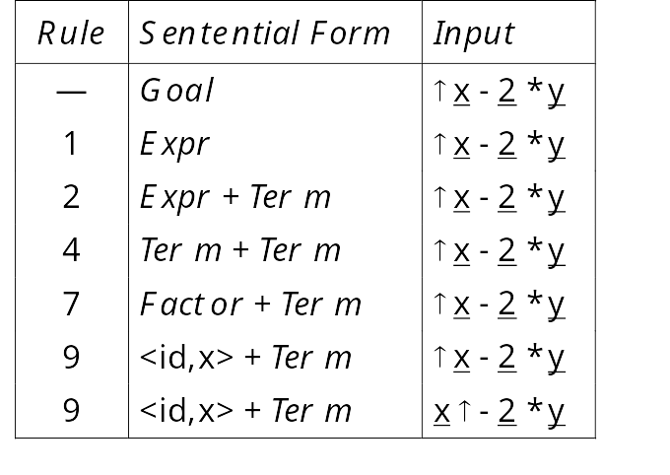
Solution
Goal
Let’s try x - 2 * y :
Expr
Expr
+
Term
Term
Fact.
<id,x>

Slide 67
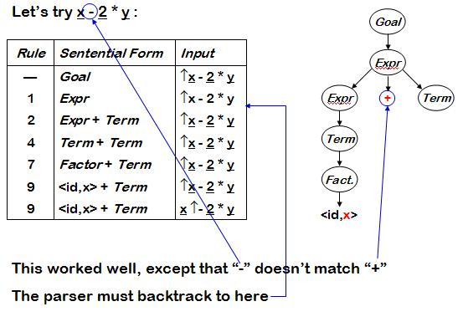
Solution

Slide 68
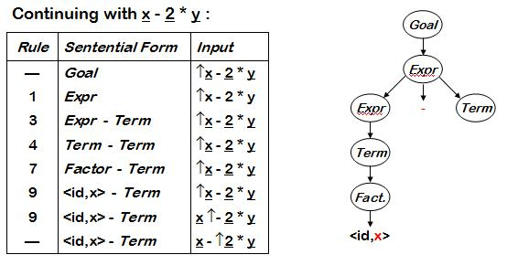
Solution

Slide 69
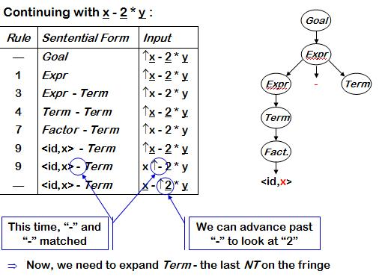
Solution

Slide 70
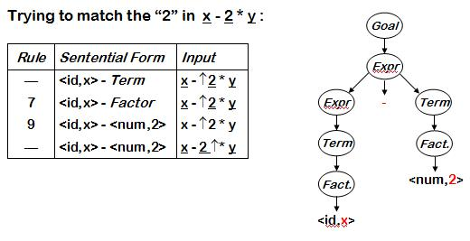
Solution

Slide 71
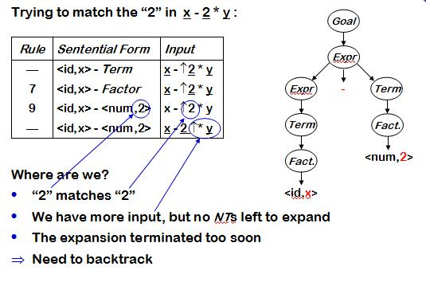
Solution

Slide 72
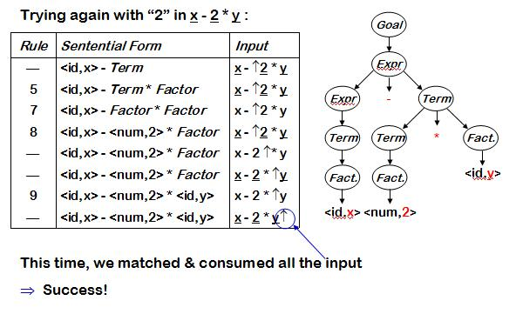
Solution

Slide 73
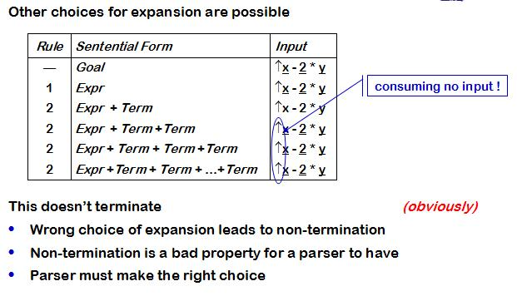
Solution

Slide 74
Let’s Revise !!

Slide 75
Concept about top down parsing
Using derivations to find a parse tree for any input
Concept about back tracking
When to use back tracking while making a parse tree.

